Slide 1
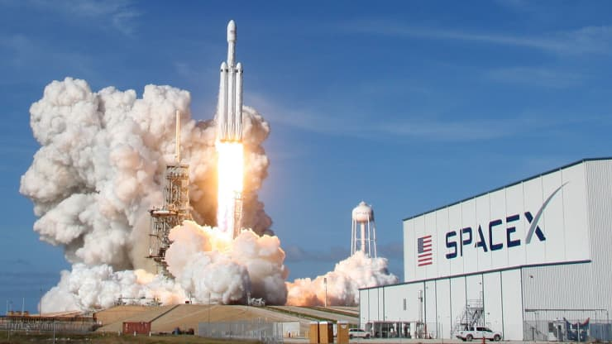







SpaceX’s Falcon 9- Recovering First Stage
Niorys Salazar
April- 2022

Slide 2


OUTLINE
Executive Summary
Introduction
Data Methodology
Data Analysis Results
Conclusion

Slide 3
EXECUTIVE SUMMARY
Data Methodologies
Collection
Scraping
Analytics Methodologies
Interactive
Predictive
Results
EDA Visualization
EDA SQL
Map – Folium
Predictive Analysis
Dashboard
Wrangling

Slide 4
INTRODUCTION
SpaceX designs, manufactures and launches the world’s most advanced rockets and spacecraft. The company was founded in 2002 by Elon Musk to revolutionize space transportation, with the goal of making life multiplanetary. SpaceX believes a fully and rapidly reusable rocket is the pivotal breakthrough needed to substantially reduce the cost of space access.
Falcon 9 is the world’s first orbital class reusable rocket. SpaceX has launched successfully 31 carrier rockets Falcon 9 in 2021. Reusability allows SpaceX to turn drives down the cost of space access.
In this capstone project, we will predict if the Falcon 9 first stage will land successfully. SpaceX advertises Falcon 9 rocket launches on its website, with a cost of 62 million dollars; other providers cost upward of 165 million dollars each, much of the savings is because SpaceX can reuse the first stage. Therefore, if we can determine if the first stage will land successfully, we can determine the cost of a launch.

Slide 5
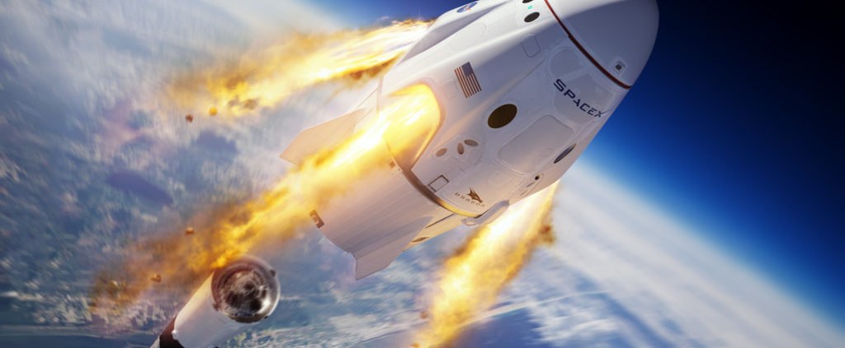
DATA METHODOLOGY

Slide 6

Data Collection & Scraping Methodology
Data collection was done using get request to the SpaceX API
Decode the response content using .json() function call
Turn it the json function into a pandas dataframe using .json normalize()
Clean the data, checking for missing values and fill them where is necessary
Performed web scraping from Wikipedia for Falcon 9 launch records with BeautifulSoup and converting it to a pandas dataframe for analysis

Slide 7
Data Wrangling Methodology
Transforming data for Machine Learning
Performing exploratory data analysis and determined the training labels.
Calculating the number of launches at each site, and the number and occurrence of each orbits
Creating landing outcome label from outcome column and exported the results to csv.
One-hot encoding was applied to categorical features

Slide 8
EDA with Data Visualization Methodology
Exploratory Data Analysis (EDA) is a process of describing the data by means of statistical and visualization techniques in order to bring important aspects of that data into focus for further analysis.
We performed exploratory Data Analysis and Feature Engineering using Pandas and Matplotlib.
We explored the data by visualizing the relationship between flight number and launch Site, payload and launch site, success rate of each orbit type, flight number and orbit type, payload and orbit type, the launch success yearly trend.

Slide 9
EDA with SQL Methodology
Exploratory data analysis is a tool to help you understand its structure, form, and size, as well as find patterns running SQL statements in Pandas .
We wrote and execute SQL queries to find out the following and more:
The names of unique launch sites in the space mission.
The total payload mass carried by boosters launched by NASA (CRS)
The average payload mass carried by booster version F9 v1.1
The total number of successful and failure mission outcomes
The failed landing outcomes in drone ship, their booster version and launch site names for in specific year.

Slide 10
Interactive Visual Analytics Methodology
The Folium library which combines Python's data analysis and detailed mapping capabilities.
In this project we enabled Plotly Dash library which empowers us to build beautiful looking, interactive and easy to share dashboards.
We marked on the map all launch sites, and added map objects such as markers, circles, and lines to mark the success or failure of launches for each site on the folium map.
We built an interactive dashboard with Plotly dash, and we plotted pie charts and other graphs showing the relationship with the interested variables.

Slide 11
Predictive Analysis - Classification Methodology
One of the most common predictive analytics models are classification models. This model categorizes information based on historical data.
We loaded the data using numpy and pandas, transformed the data, split our data into training and testing.
We built different machine learning models and tune different hyperparameters using GridSearchCV.
We found the best performing classification model.

Slide 12
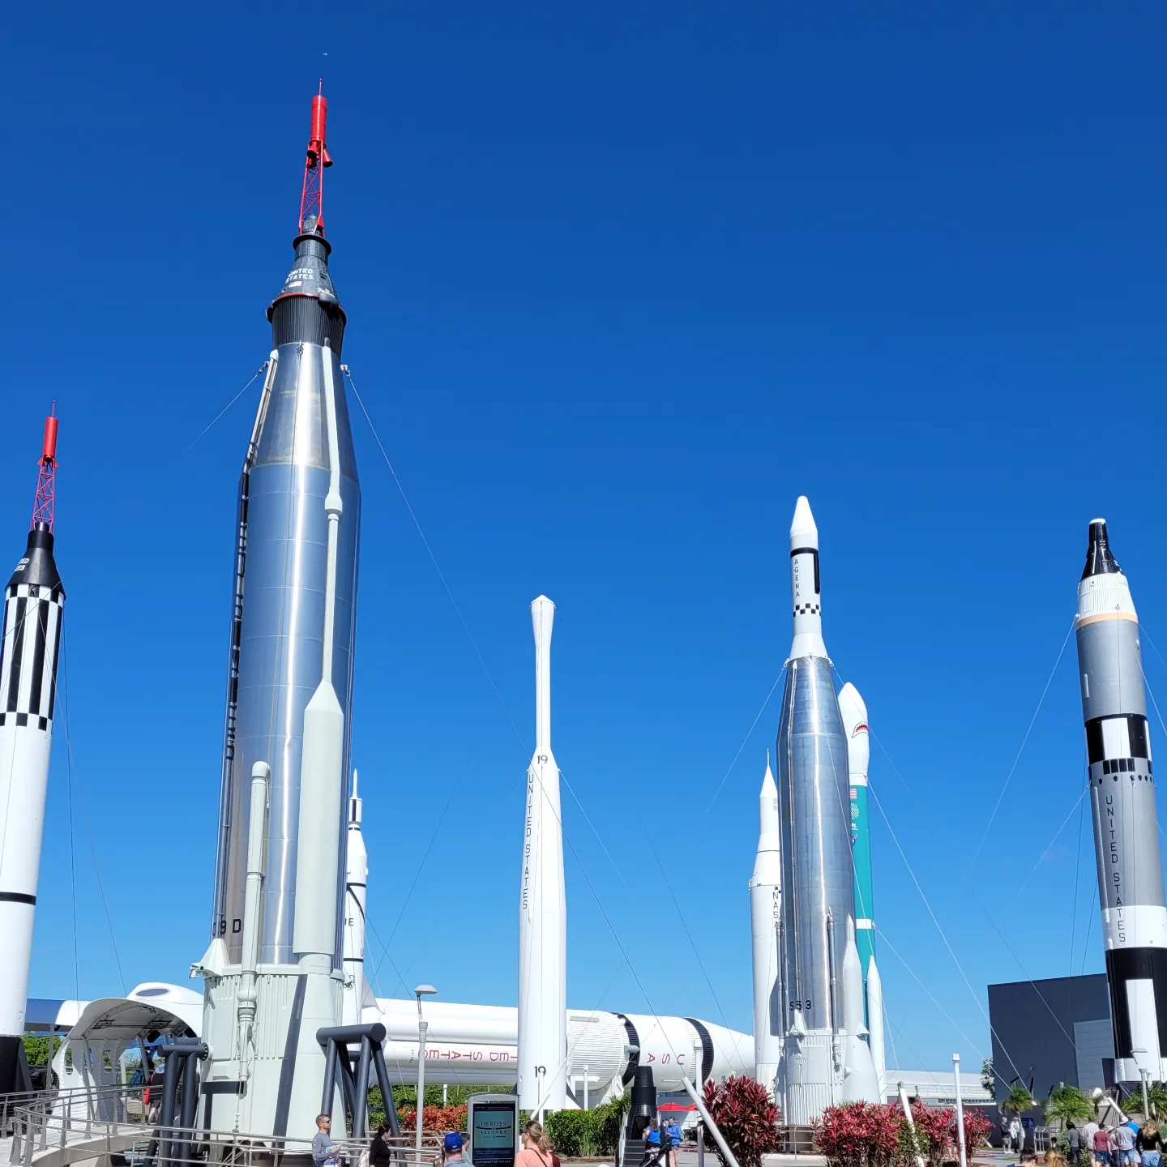
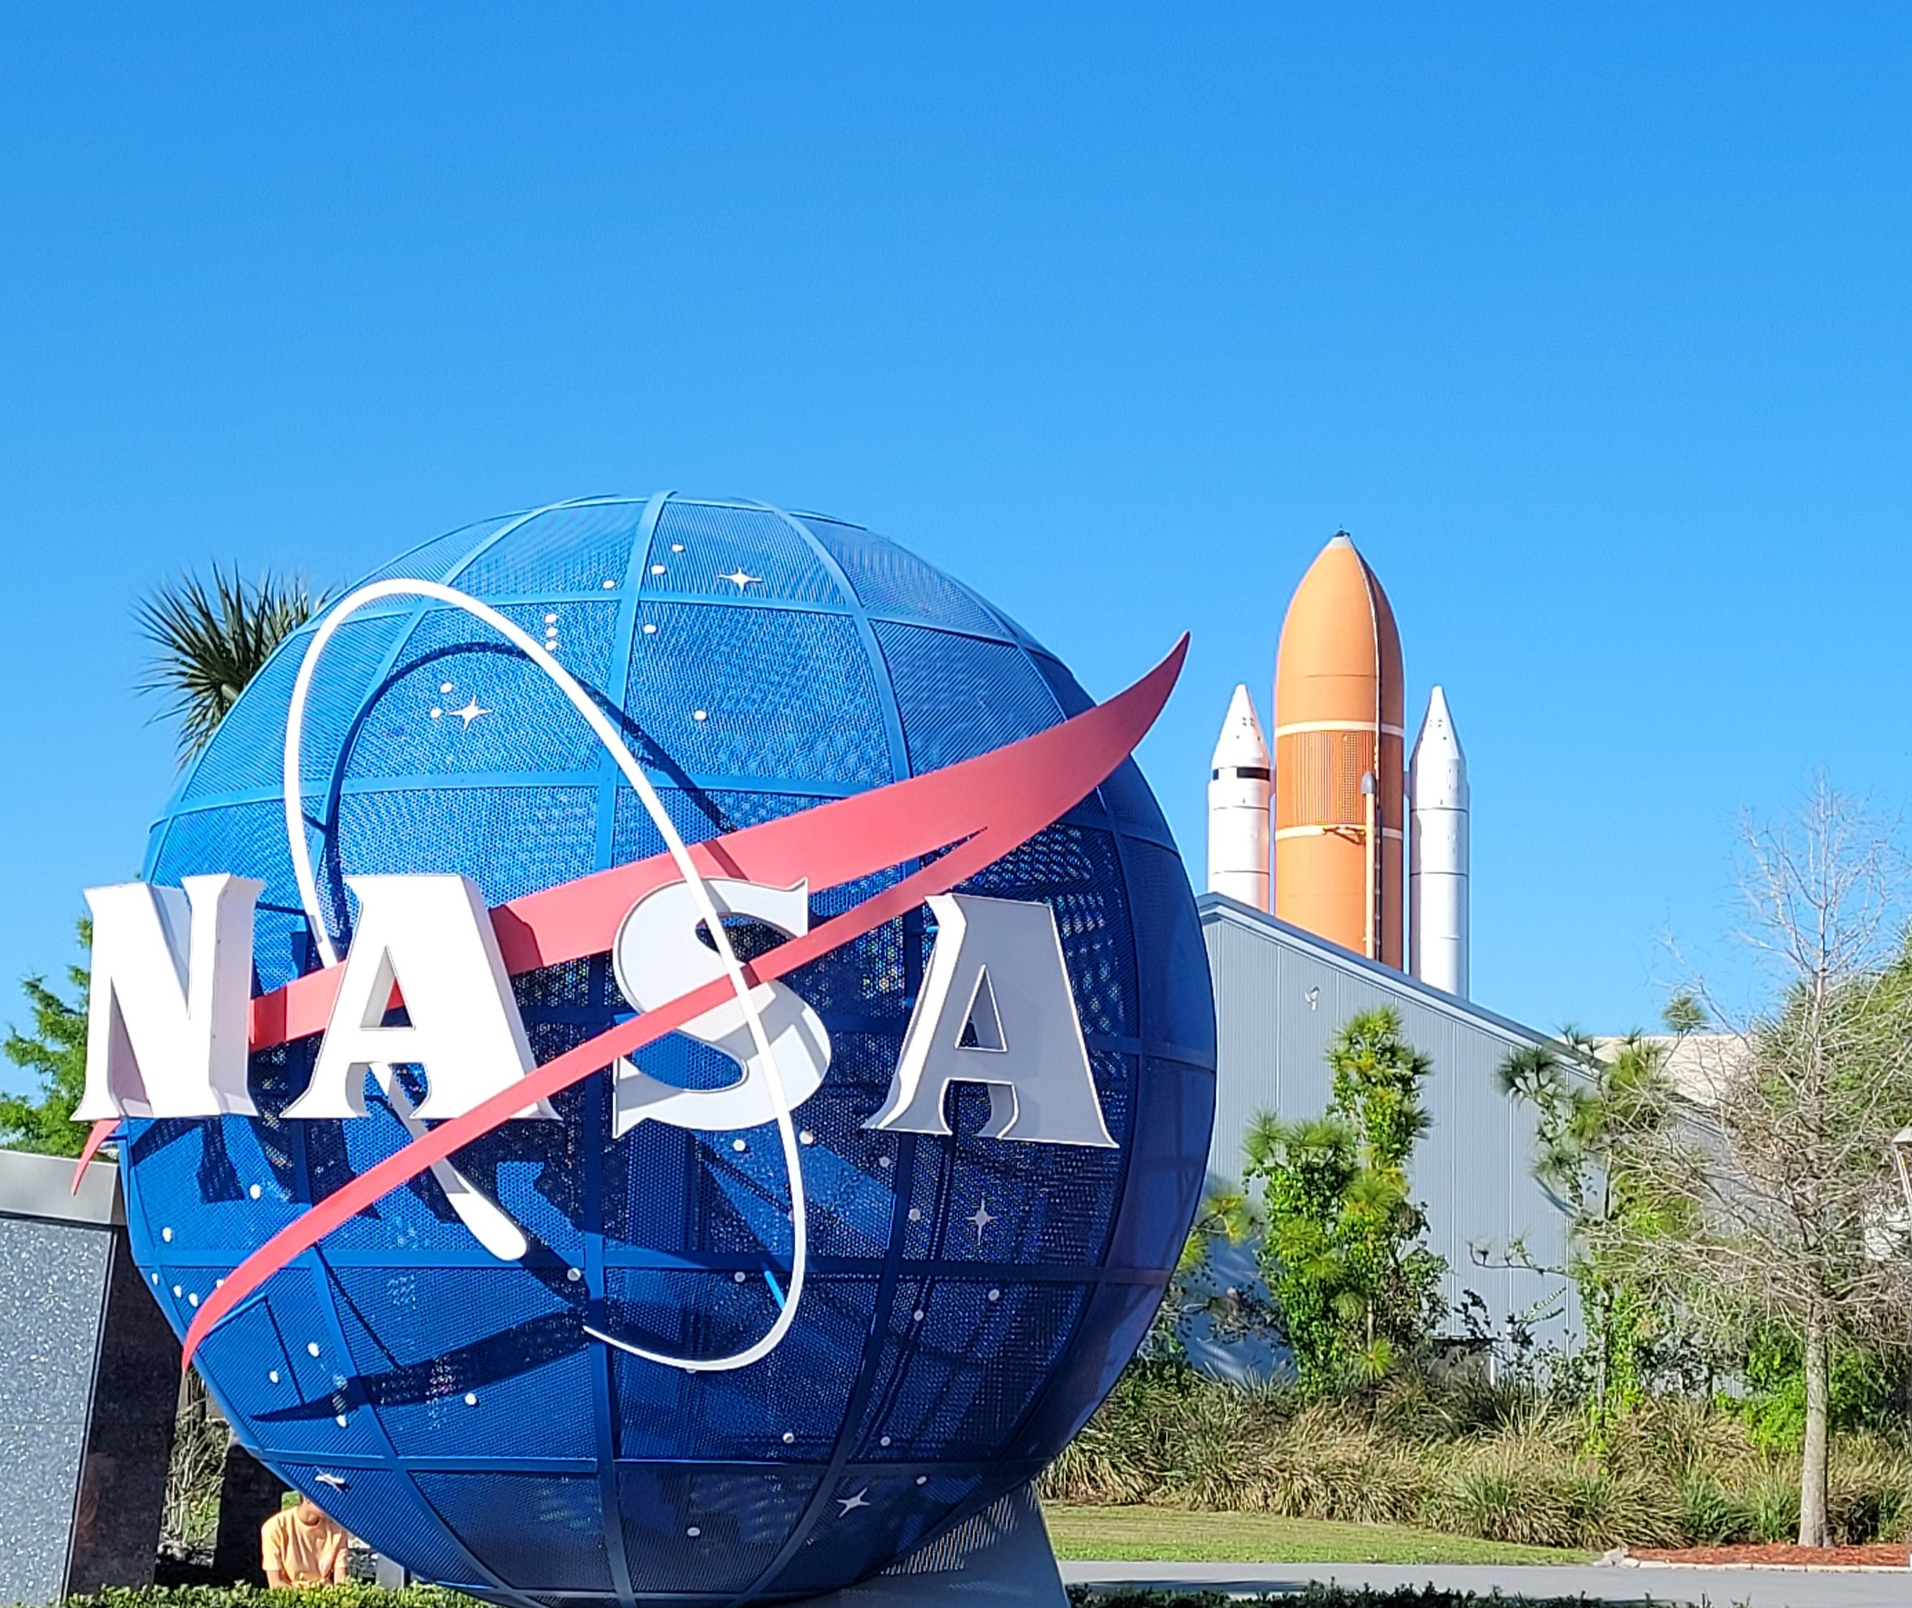
Data Analysis Results

Slide 13

Data Collection Get request to the SpaceX API
https://github.com/Francys73/Final-Data-ScienceProject/blob/master/Data%20Collection%20API%20Lab.ipynb
spacex_url="https://api.spacexdata.com/v4/launches/past"
Request
Pandas
Numpy
BoosterVersion
LaunchSite
PayloadData
CoreData
static_json_url
json_normalize
json result into a dataframe
Data wrangling
Import Libraries
Define Functions
Response

Slide 14
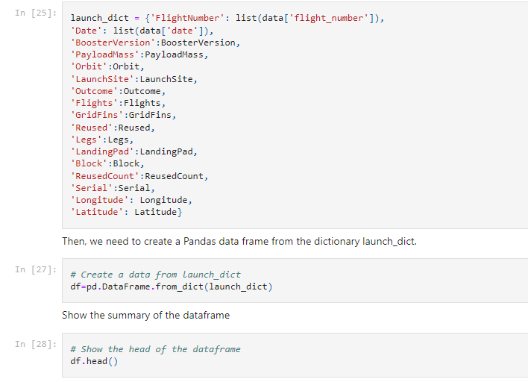

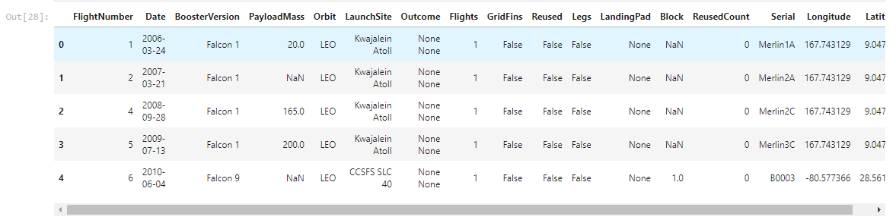
Data Collection Get request to the SpaceX API
https://github.com/Francys73/Final-Data-ScienceProject/blob/master/Data%20Collection%20API%20Lab.ipynb

Slide 15
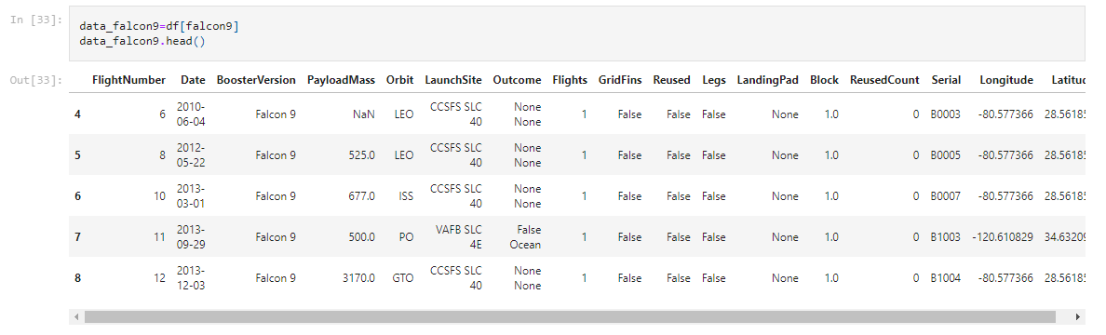
Data Collection Get request to the SpaceX API
https://github.com/Francys73/Final-Data-ScienceProject/blob/master/Data%20Collection%20API%20Lab.ipynb
The data from these requests was stored in lists and used to create a new dataframe
Filtered the dataframe using BoosterVersion column only by “Falcon 9” data
Dataframe data_falcon9

Slide 16
Data Scraping
Web scraping Falcon 9 and Falcon Heavy Launches Records
https://github.com/Francys73/Final-Data-Science-Project/blob/master/Data%20Collection%20with%20Web%20Scraping%20lab.ipynb
BeautifulSoup
Request
re
Unicodedata
Pandas
Booster version
Date time
Landing_status
Mass
Extract Tables
Extract columms
Extract rows
Dataframe df by parsing the launch HTML tables
Dataframe
Data_Falcon9
HTML Table
Define Functions
Response
Scraped data from a snapshot of the List of Falcon 9 and Falcon Heavy launches Wikipage updated on 9th June 2021
https://en.wikipedia.org/w/index.php?title=List_of_Falcon_9_and_Falcon_Heavy_launches&oldid=1027686922

Slide 17
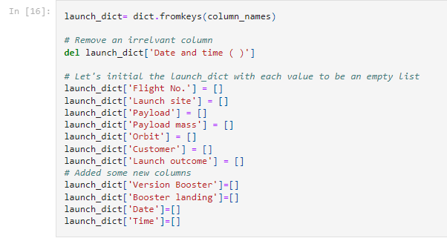
Data Scraping
Web scraping Falcon 9 and Falcon Heavy Launches Records
Dictionary creation with keys from the extracted column names.
We can use Panda Dataframes to scrape directly an HTML table from a URL. This can be incredibly useful and a quick way to extract useful data.

Slide 18
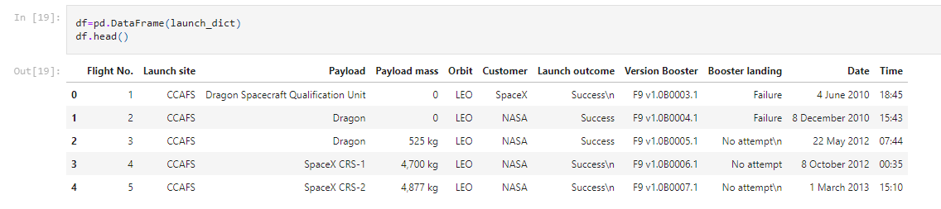
Data Scraping
Web scraping Falcon 9 and Falcon Heavy Launches Records
Data frame (df) created after have fill the parsed launch record values into launch_dict

Slide 19
EDA with Data Visualization
Space X Falcon 9 First Landing Prediction
Pandas
Numpy
Matplotlib
Seaborn
Exploratory Data Analysis
Preparing Data Feature Engineering
Visualizing relationship:
Flight # vs. Payload Mass
Payload vs. Launch Site
Success rate by orbit
Flight # vs. Orbit type
Launch success trend
Exploring and preparing Data
Objectives
Response
https://github.com/Francys73/Final-Data-Science-Project/blob/master/EDA%20with%20Visualization%20lab.ipynb

Slide 20

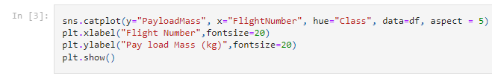
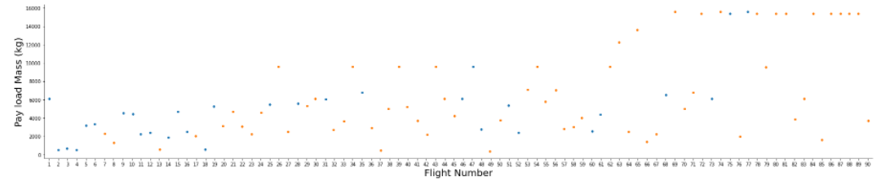
EDA with Data Visualization
Space X Falcon 9 First Landing Prediction
Flight # vs. Payload Mass

Slide 21
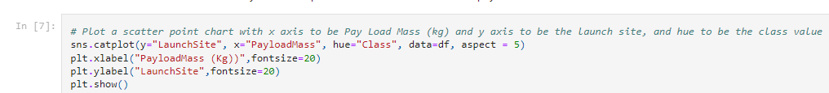
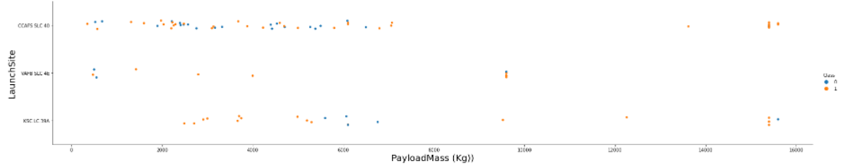
EDA with Data Visualization
Space X Falcon 9 First Landing Prediction
Payload vs. Launch Site

Slide 22
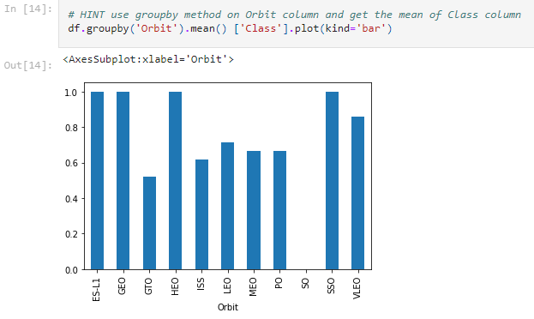

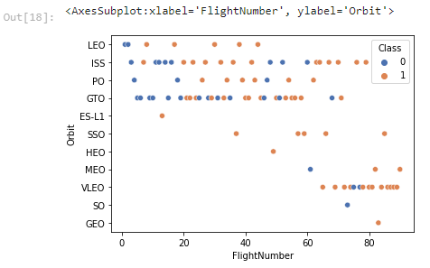
EDA with Data Visualization
Space X Falcon 9 First Landing Prediction
Success rate by orbit
Flight # vs. Orbit type

Slide 23
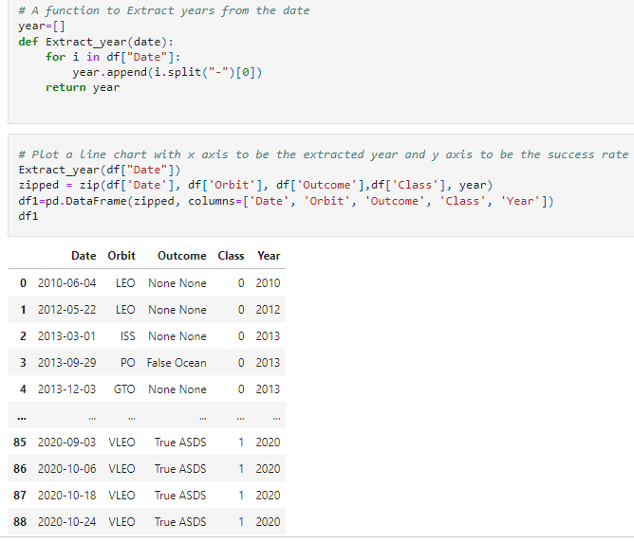
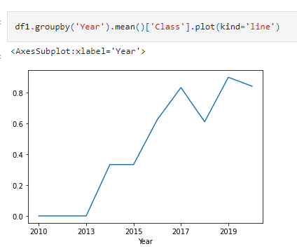
EDA with Data Visualization
Space X Falcon 9 First Landing Prediction
Launch success yearly trend
Success rate 2010-2020

Slide 24
EDA with SQL
Space X Falcon 9 First Landing Prediction
Pandas
Numpy
Matplotlib
Seaborn
Understand the Spacex dataset
Load the dataset into Db2 database
Execute SQL queries
Queries results:
Unique Launch sites
Total Payload mass carried by boosters
Average payload mass
Total number of successful and failures outcomes
Execute SQL queries to analyze the Spacex dataset
Objectives
Response
https://github.com/Francys73/Final-Data-Science-Project/blob/master/EDA%20with%20SQL%20lab.ipynb

Slide 25

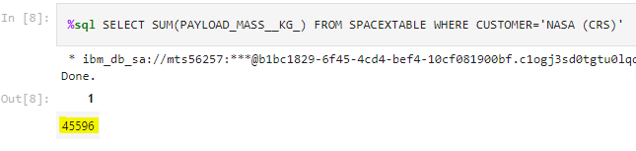
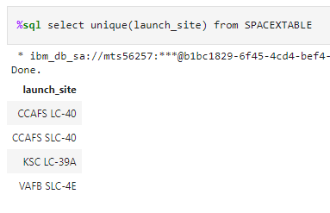
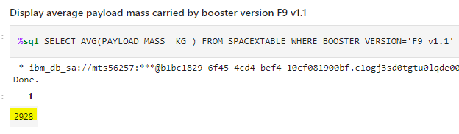
%sql ibm_db_sa
EDA with SQL
Space X Falcon 9 First Landing Prediction
Download the datasets (Spacex DataSet)
Connect to the database (sql ibm_db_sa)
Total Payload mass carried by boosters
Unique Launch sites
Average Payload mass carrier

Slide 26
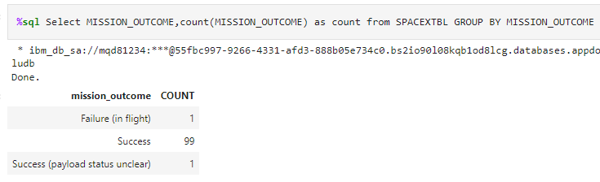
%sql ibm_db_sa
EDA with SQL
Space X Falcon 9 First Landing Prediction
Download the datasets (Spacex DataSet)
Connect to the database (sql ibm_db_sa)
Total number of successful and failure mission outcomes

Slide 27
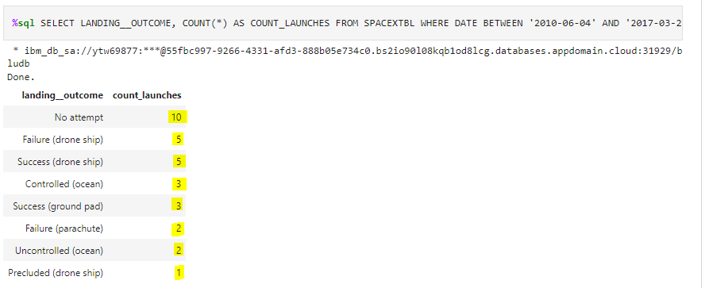
%sql ibm_db_sa
EDA with SQL
Space X Falcon 9 First Landing Prediction
Download the datasets (Spacex DataSet)
Connect to the database (sql ibm_db_sa)
Rank the count of lading outcomes between 2010-2017

Slide 28
Interactive Map with Folium
Results
Launch Sites Locations Analysis
https://github.com/Francys73/Final-Data-Science-Project/blob/master/Interactive%20Visual%20Analytics%20with%20Folium%20lab.ipynb
Folium
Wget
Pandas
MarketCluster
MousePosition
DivIcon
Download data (wget)
Select Columns
Folium Map object (NASA)
Site Map
Spacex_df (site coordinates)
Map with all launch sites
Map with success/failed launches
Distances from a launch sites
Launch Sites Locations Analysis
Define Functions
Response
Dataset spacex_launch_geo.csv is an augmented dataset with the coordinates for each site.
https://cf-courses-data.s3.us.cloud-object-storage.appdomain.cloud/IBM-DS0321EN-SkillsNetwork/datasets/spacex_launch_geo.csv

Slide 29
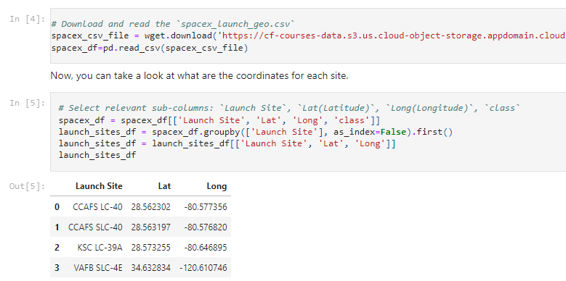
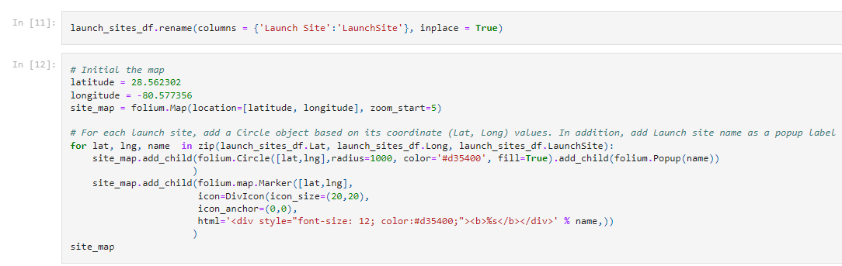
Interactive Map with Folium
Launch Sites Locations Analysis
Mark all launch sites on a map

Slide 30
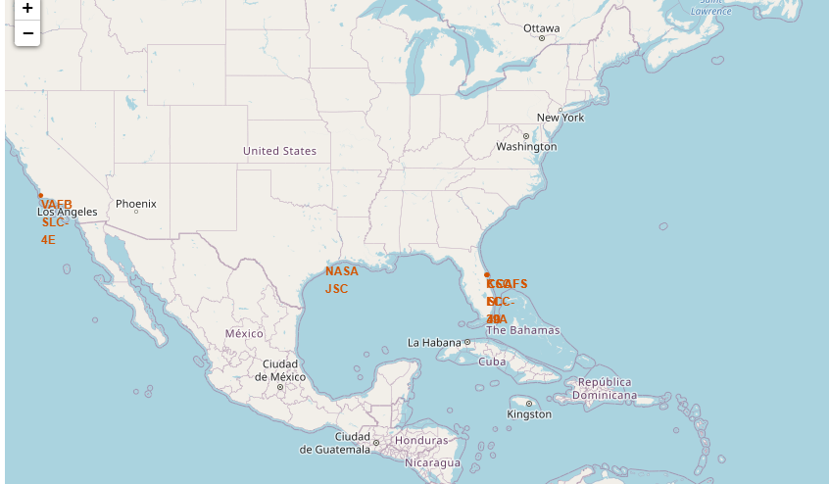
Interactive Map with Folium
All Launch Sites on a Map

Slide 31
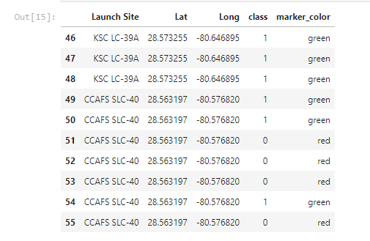
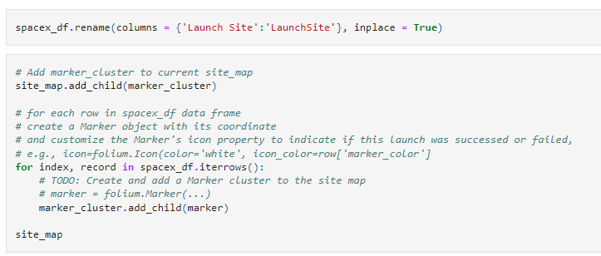
Interactive Map with Folium
Launch Sites Locations Analysis
Map with success/failed launches

Slide 32
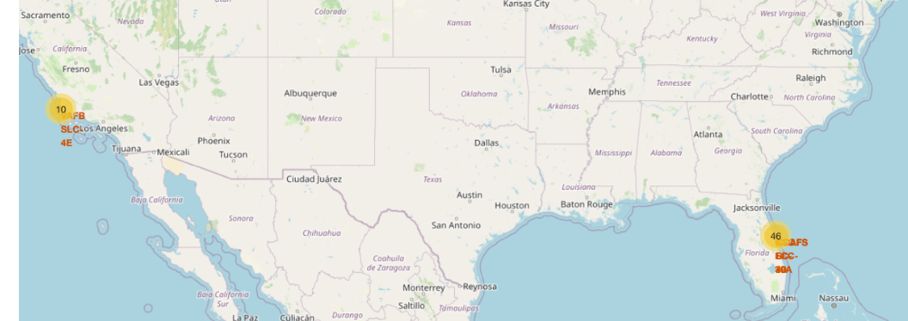
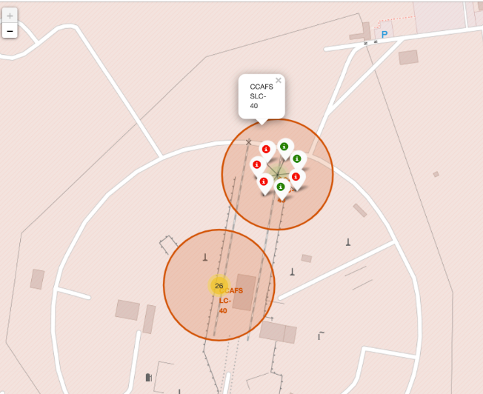


Interactive Map with Folium
The Success/Failed launches on the Map
Launch was successful (class=1)
Launch was failed (class=0)

Slide 33
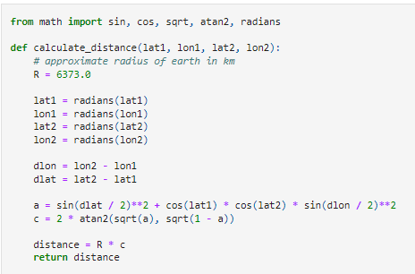
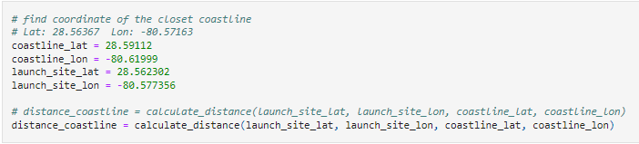
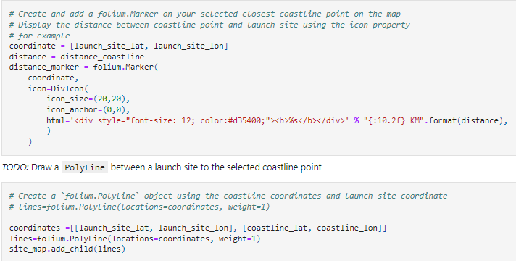
Interactive Map with Folium
Distances between proximities sites

Slide 34
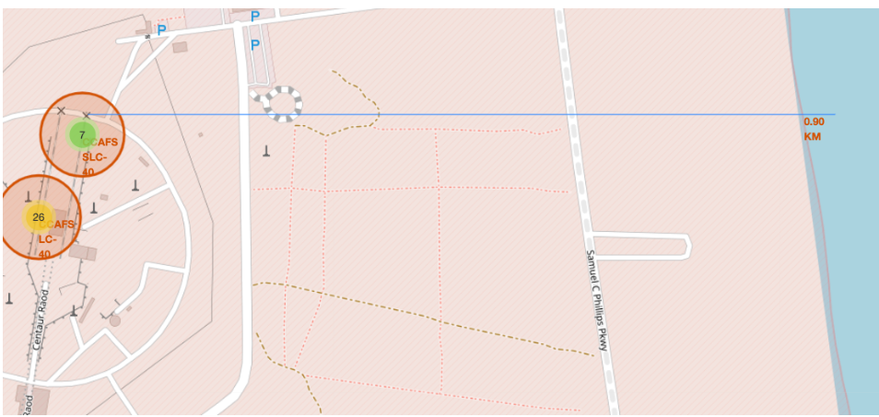
Interactive Map with Folium
Distances between proximities sites
Distance between CCAFS SLC-40 Launch site and the point Coast
0.9 Km

Slide 35
Predictive Analysis – Classification
Results
SpaceX Falcon 9 First Stage Landing Prediction
https://github.com/Francys73/Final-Data-Science-Project/blob/master/Machine%20Learning%20Prediction%20lab.ipynb
matplotlib
seaborn
Sklear:
preprocessing
train_test_split
GridSearchCV
LogisticRegression
Create a columm for the class
Standardize the data
Split into training and test data
Find the best prediction method
GridSearchCV object
K nearest neighbor object
Decision Tree Classifier
Confusion Matrix to calculate Accuracy
Perform exploratory Data Analysis and Training Labels
Objectives
Response
Loading Data Frame
https://cf-courses-data.s3.us.cloud-object-storage.appdomain.cloud/IBM-DS0321EN-SkillsNetwork/datasets/dataset_part_2.csv

Slide 36

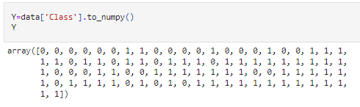
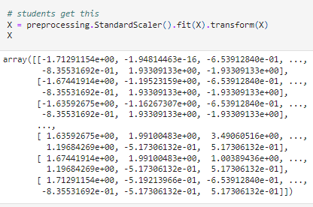
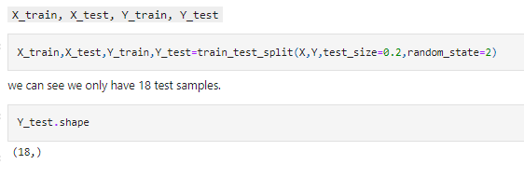
Predictive Analysis –Classification
Results
SpaceX Falcon 9 First Stage Landing Prediction
Create NumPy array
Standardize the data in X
Split the data X and Y into training
(80%) and test data (20%)
1.
2.
3.

Slide 37
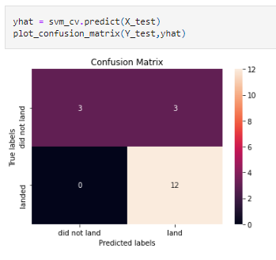
Predictive Analysis –Classification
Results
Classification Accuracy using training data
Confusion Matrix for Tree Classifier Algorithm
Algorithm | Accuracy
Support vector svm_cv | 0.8482142857142856
Tree classifier tree_cv | 0.8892857142857142
Logistic Regression logreg_cv | 0.8464285714285713
Total positive 12
False positive 3
Total Negative 3
Falso Negative 0
Best algorithm Tree Classifier with an accuracy of 88.92%

Slide 38
CONCLUSION
SpaceX has savings on Falcon 9 rocket launches since they can reuse the first stage. Using data analysis tools, we can predict if the Falcon 9 first stage will land successfully.
Low weighted payloads perform better than the heavier payloads.
Orbits ES-L1, GEO, HEO, SSO, VLEO had the most success rate.
The Launches success rate started to increase since 2013 to the present as they have perfected the launches with trial and error.
KSC LC-39A had the most successful launches of any sites.
The tree classifier algorithm is the best for this project dataset.

Slide 39
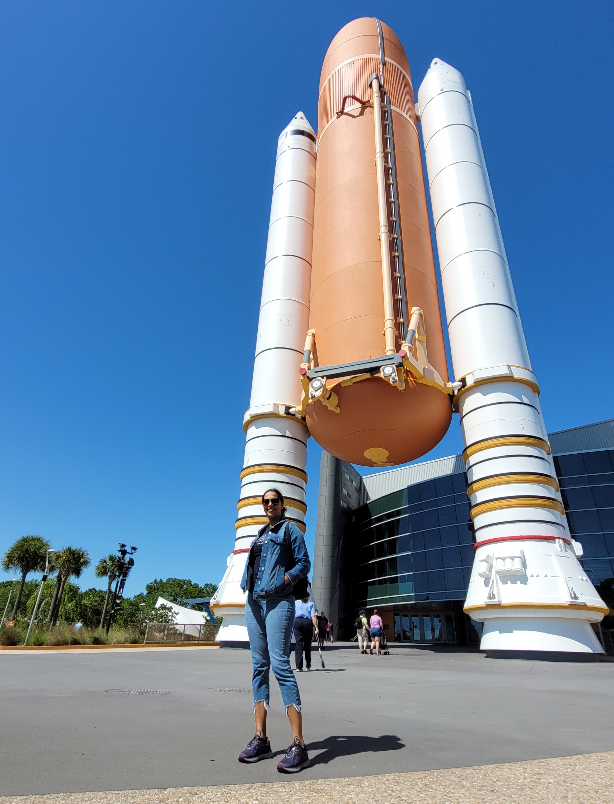






SpaceX’s Falcon 9- Recovering First Stage
Thank you!
Visit to The Kennedy Space Center
March 2022

